Slide 1
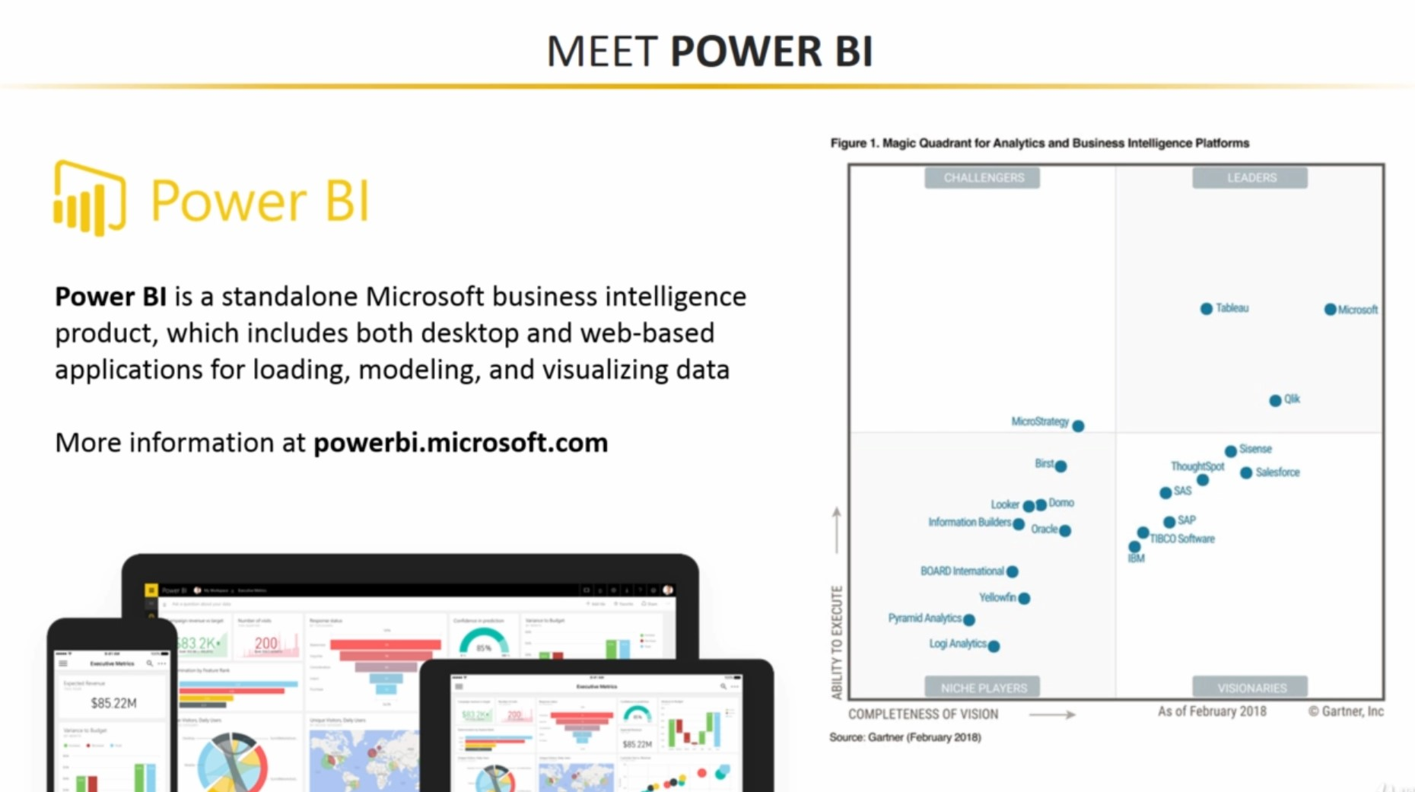

Slide 2
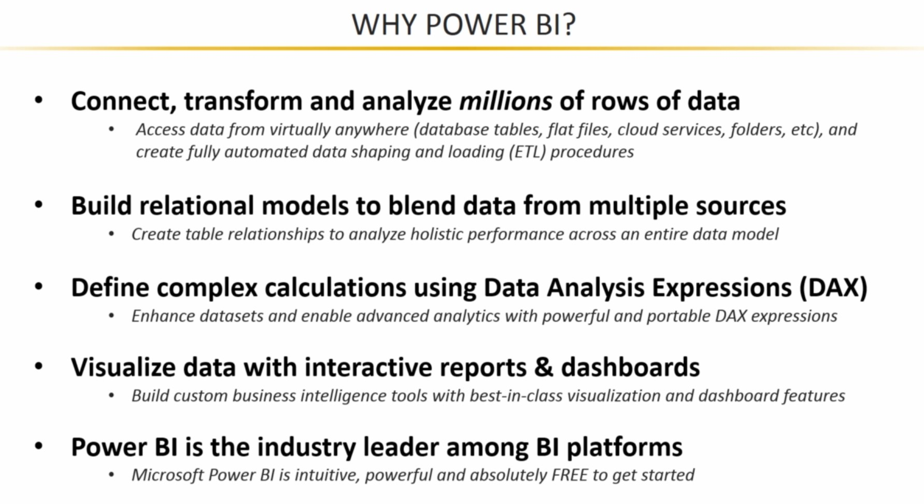

Slide 3

STEPS IN POWER BI
Data Understanding and Preparation
Business Requirements - understand the business problem
Connecting to data Sources
Extract data from CSV
Transform data using Power Query
Modelling the Data-Relationships
Build data table model relationships
Dax functions in Power BI
Transform data using DAX formula
Measures and Columns
Build a report by - Creating Visualizations
Building Basic Visuals
Dynamic Page navigation

Slide 4
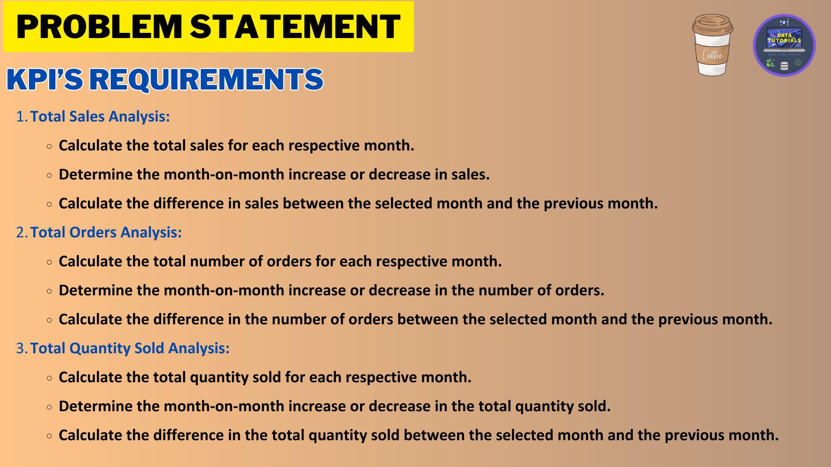

Slide 5
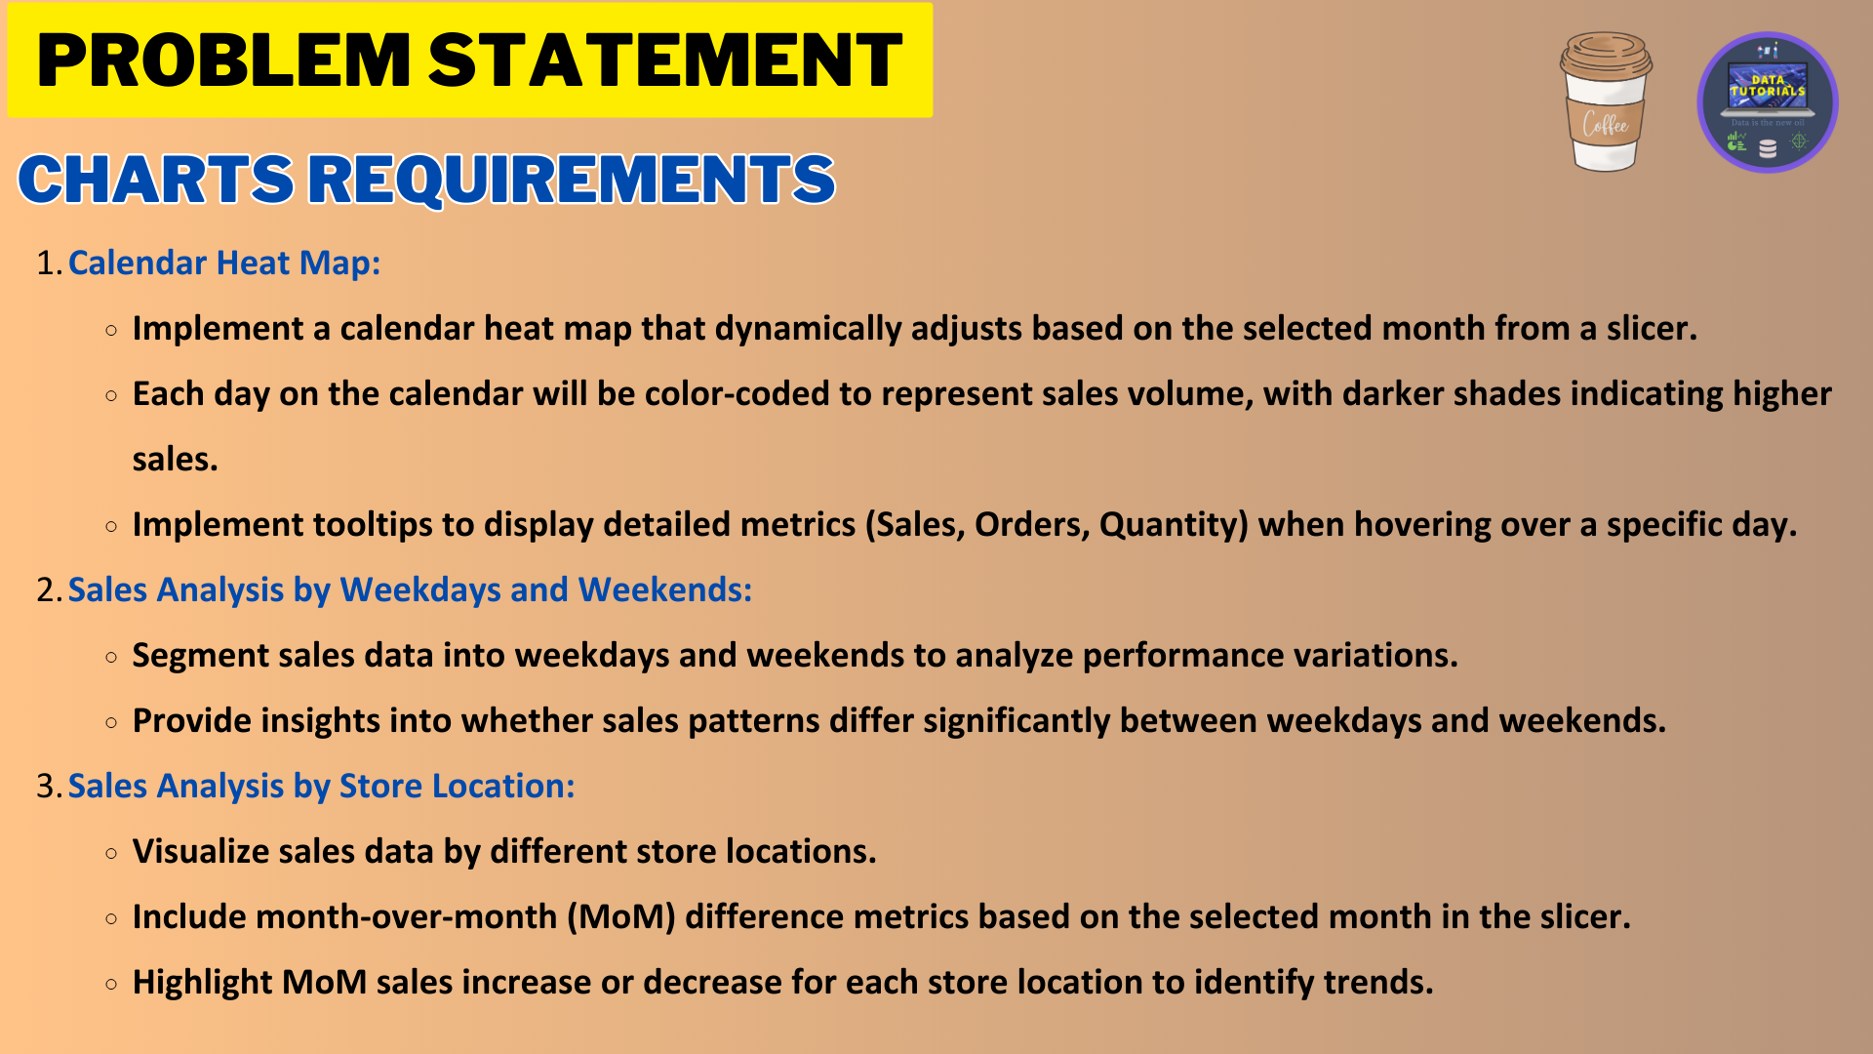
*
4. Sales Analysis by Weekdays and Weekends:
Segment sales data into weekdays and weekends to analyze performance variations.
Provide insights into whether sales patterns differ significantly between weekdays and we
5. Sales Analysis by Store Location:
Visualize sales data by different store locations.

Slide 6
